Slide 1
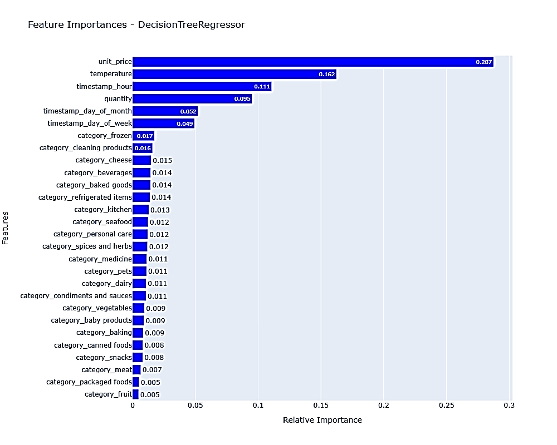
Yes, we can accurately predict the stock levels of products based on sales data and sensor data on an hourly basis in particular cases, in order to more intelligently procure products from our suppliers
From the plot given we can infer that unit_price and temperature and timestamp_hour are the top-3 features that affect the estimated_stock_pct
The Relative Importance of unit_price is 0.287(28.7%), temperature is 0.162(16.2%) and that of timestamp_hour is 0.111(11.1%)
These Relative Importance scores are the scores are how the feature has an impact on the selected target variable in our case it’s estimated_stock_pct
So, we can tell that unit_price, temperature and timestamp_hour has some impact on the estimated_stock_pct.

Slide 2
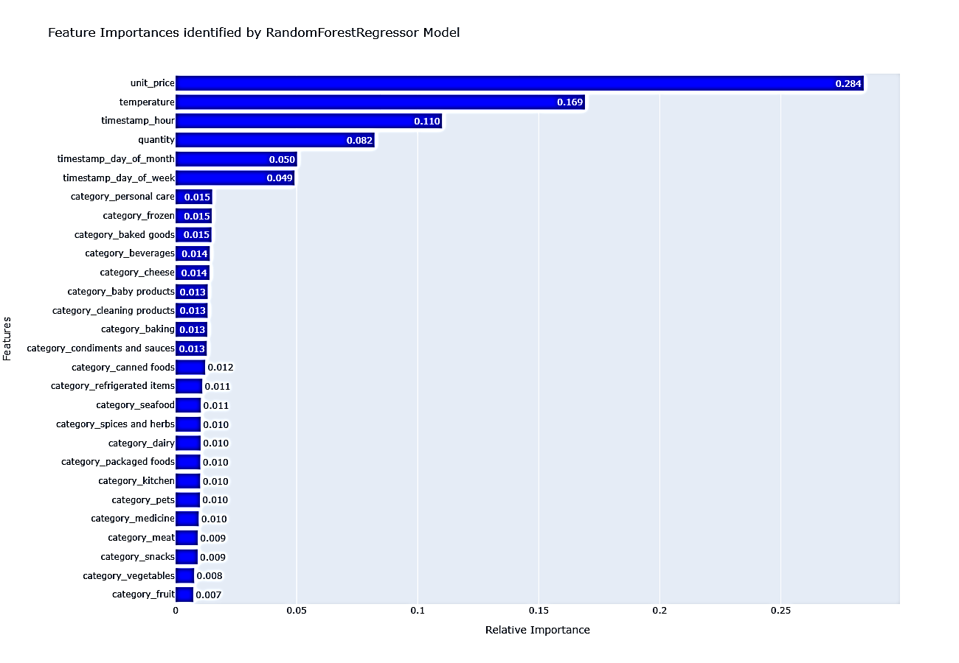
Yes, we can accurately predict the stock levels of products based on sales data and sensor data on an hourly basis in particular cases, in order to more intelligently procure products from our suppliers
From the plot given we can infer that unit_price and temperature and timestamp_hour are the top-3 features that affect the estimated_stock_pct
The Relative Importance of unit_price is 0.284(28.4%), temperature is 0.169(16.9%) and that of timestamp_hour is 0.110(11.0%)
These Relative Importance scores are the scores are how the feature has an impact on the selected target variable in our case it’s estimated_stock_pct
So, we can tell that unit_price, temperature and timestamp_hour has some impact on the estimated_stock_pct.

